Slide 1

MSADS Portfolio Milestone
Gianni C. Conde
SUID: 734859774
gcconde@syr.edu
Spring 2024

Slide 2
Introduction: Program Goals
The Applied Data Science program at Syracuse University supplies students with the expertise to thrive in the analytically driven realm of data science.
The expertise that this program provides to students include:
Data collection, storage, and accessibility through identification and leveraging of applicable technologies.
Create obtainable insight from data pertaining to various industries while utilizing the full data science life cycle.
Generate actionable insight with the application of predictive models and visualizations.
Efficient use of programming languages such as Python, R, SQL, etc.
Communication of analytical insights and visualizations to a broad range of stakeholders.
Ethical development, use, and evaluation of data and models to ensure fairness, privacy, and bias.

Slide 3
Introduction: Projects
Throughout my time in the program, these skills are evident in the following projects:
IST 659: Data Administration Concepts & Database Management
IST 707: Applied Machine Learning
IST 736: Text Mining.
The code repository can be accessed in the link below: https://github.com/gianniconde/IST-782---MSADS.git

Slide 4
IST 659: Data Administration Concepts and Database Management
Course Description
Provided hands-on involvement when defining, developing, and managing relational databases.
The techniques included schema design, modeling, search specifications, and query languages and their application in SQL.

Slide 5

IST 659 – MLB Database Analysis: Project Description
Goal
To create a database of free agent eligible MLB players prior to the 2022 season to determine how their previous and projected seasons will impact their potential contracts.
Analysis Questions
Are players aged 32+ guaranteed to have shorter contract lengths (less than 4 years)?
How many players will have at least an average Projected 2022 WAR?
Contributor(s): Gianni Conde

Slide 6
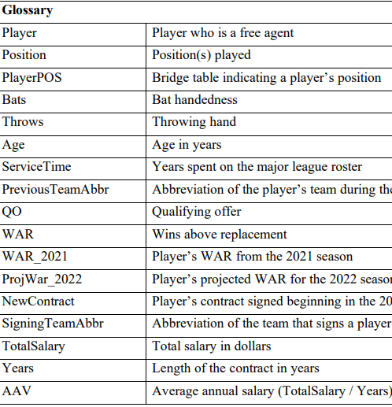
About the Data
Retrieved as a csv file from Fangraphs’ 2022 MLB Free Agent Tracker.
Includes 262 unique free agent eligible players, accompanied by attributes detailing their skillsets and their eventual contracts signed prior to the 2022 season.
The top 20 free agents based on WAR for the 2021 season will be observed.
There were 17 attributes included
The WAR attributes were the only statistical identifiers of player evaluation.

Slide 7
Business Rules
Every attribute in the data set is required except for suffix, qualifying offer (QO), and 2021 WAR.
Players traded during the 2021 season are not eligible to receive a qualifying offer.
Since the data does include multiple previous teams, each player that did not receive one will have an empty space for this attribute.
Players who did not play during the 2021 season due to injury or taking their services abroad will not have a value for 2021 WAR.
A player must play at least one position.
Age, service time, QO, years, total salary, and AAV cannot be negative.
2021 WAR and projected 2022 WAR can be negative.
Previous teams and signing teams are not multivalued.

Slide 8
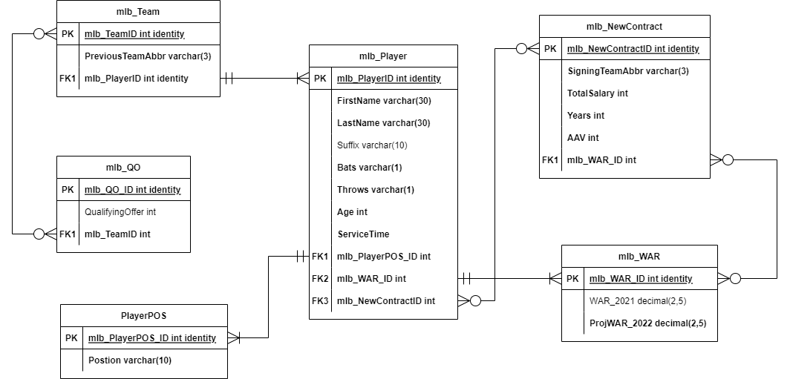
Logical Model

Slide 9
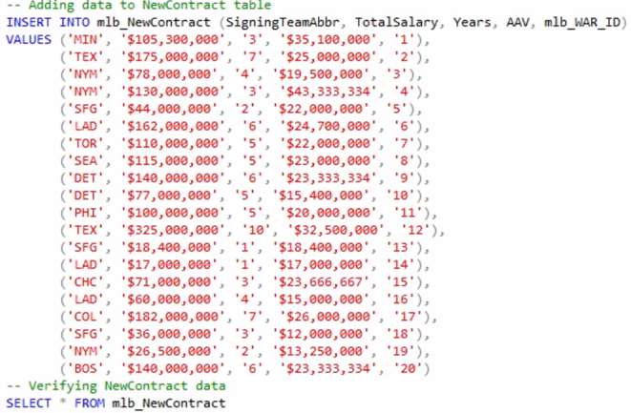
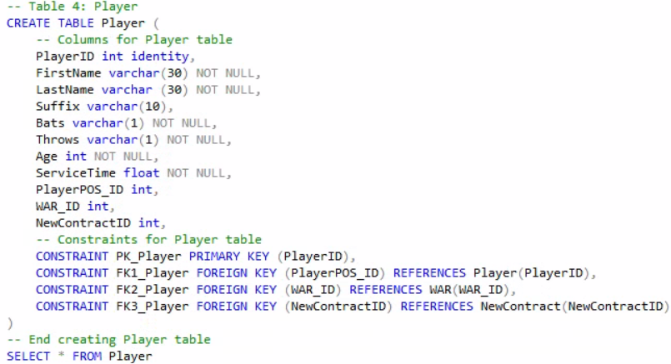
Database Design & Creation

Slide 10
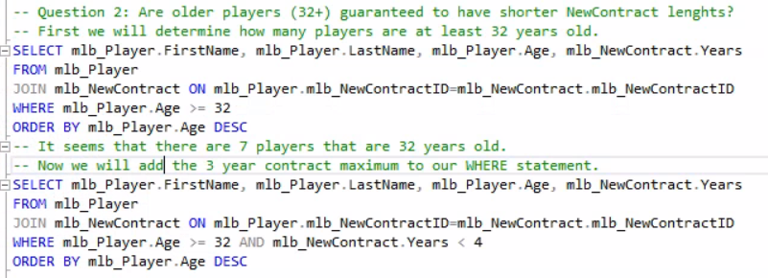
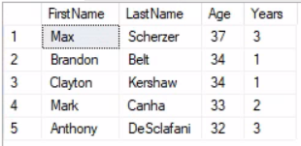
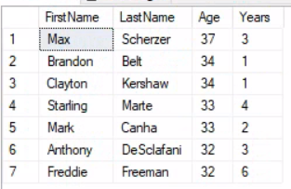
Are players aged 32+ guaranteed to have shorter contract lengths (less than 4 years)?
Players aged 32+ that received contracts with less than 4 years
Players aged 32+

Slide 11
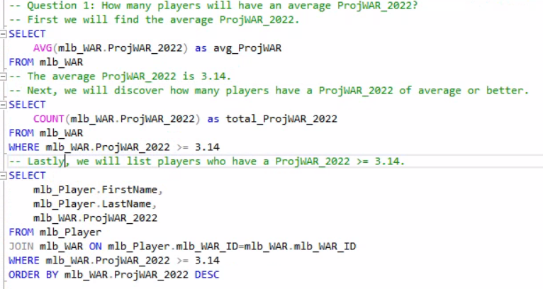
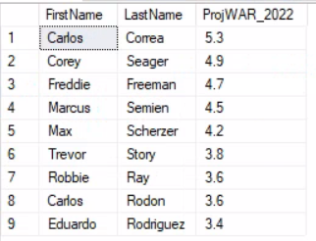
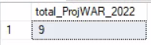
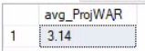
How many players will have at least an average Projected 2022 WAR?
List of players with at least an average Projected 2022 WAR
Total players with at least an average Projected 2022 WAR
Calculated average of Projected 2022 WAR

Slide 12
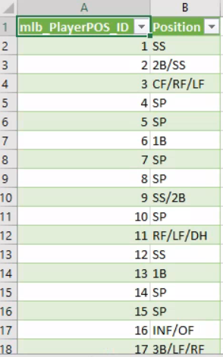
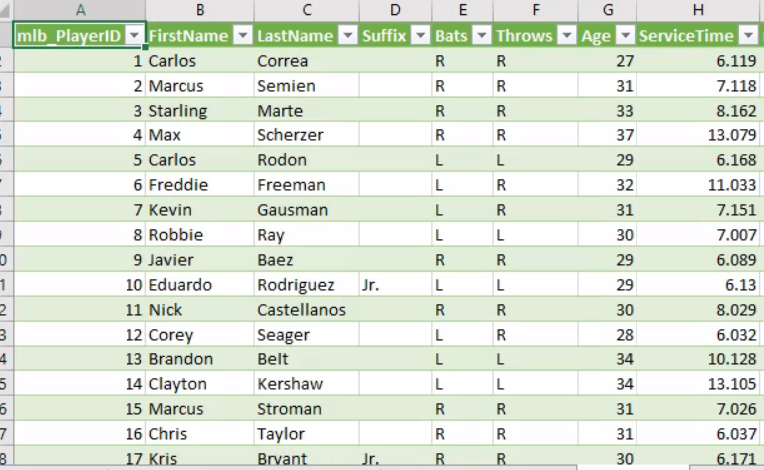
Generated Report

Slide 13
Reflection & Learning Goals
Changes made include entity names, data inclusion, and data types within entities.
Potential inclusion of player injury history could lead to more advanced data questions.
Skills gained:
Data collection
relational database management
SQL querying
Microsoft Excel for UI
communication of insights.

Slide 14
IST 707: Applied Machine Learning
Course Description
Recapitulation of procedural machine learning techniques through specialized program packages, model building, and real-world applications.
Established the foundation of data storytelling, trend discovery using R, and the ability to express technical findings to audiences.

Slide 15

IST 707 – Heart Failure Research: Project Description
Goal
To determine the event of death by heart failure based on clinical measurements by uncovering patient trends and applying supervised machine learning models and data mining techniques.
Contributor(s):
Gianni Conde, Joshua Biggs-Bauer, Joaquin Rodarte

Slide 16
About the Data
Age | Patient’s age (years) | Sex | female=0, male=1 (binary)
Anaemia | Decrease of hemoglobin (binary) | Platelets | Platelets in bloodstream (kilo platelets/mL)
High blood pressure | Hypertension (binary) | Serum creatinine | Level of creatinine in bloodstream (mg/dL)
Creatinine phosphokinase (CPK) | Level of CPK enzyme in bloodstream (mcg/L) | Serum sodium | Level of sodium in bloodstream (mEq/L)
Diabetes | If a patient has diabetes (binary) | Smoking | If the patient smokes (binary)
Ejection fraction | % Of blood leaving the heart at each contraction | Death Event | If the patient died during the follow-up period (binary)
Retrieved from Kaggle as a csv file.
Originally collected from April to December of 2015 by the Faisalabad Institute of Cardiology in Punjab, Pakistan.
Consists of medical records regarding heart failure with 299 patients and 12 clinical measurements.

Slide 17
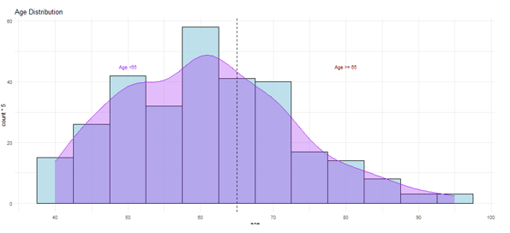
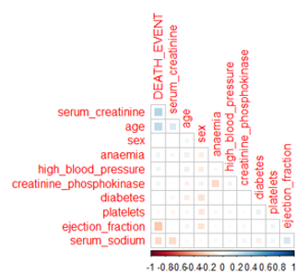
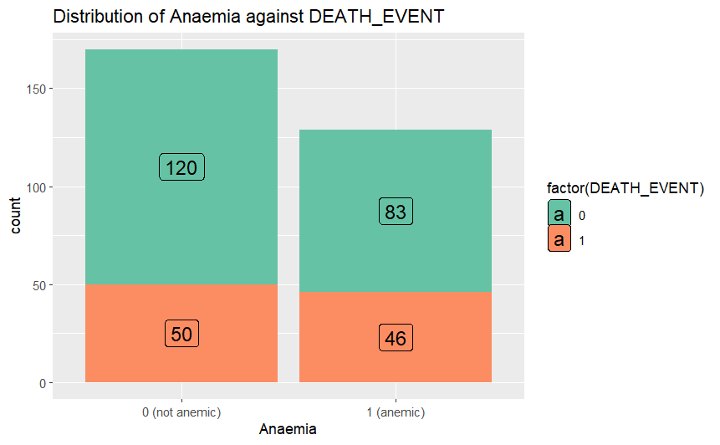
Exploratory Data Analysis

Slide 18
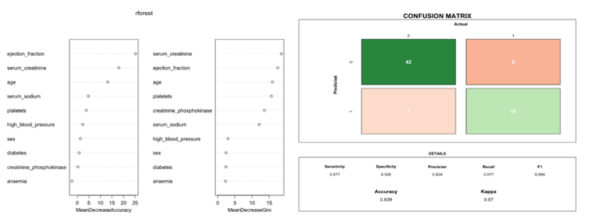
Modeling: Random Forest

Slide 19
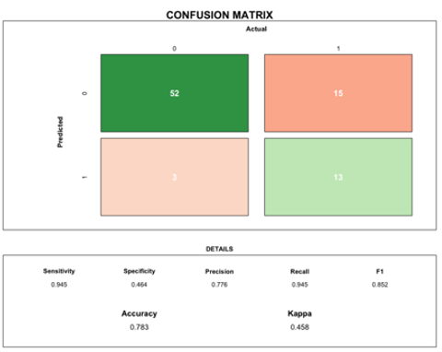
Modeling: SVM

Slide 20
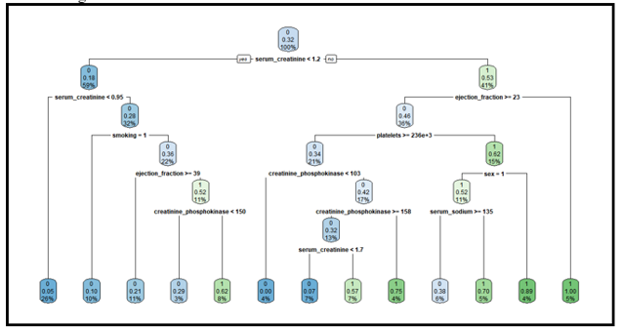
Modeling: Decision Tree

Slide 21
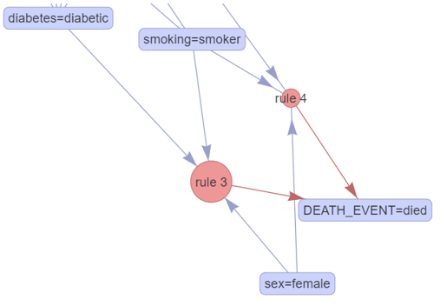
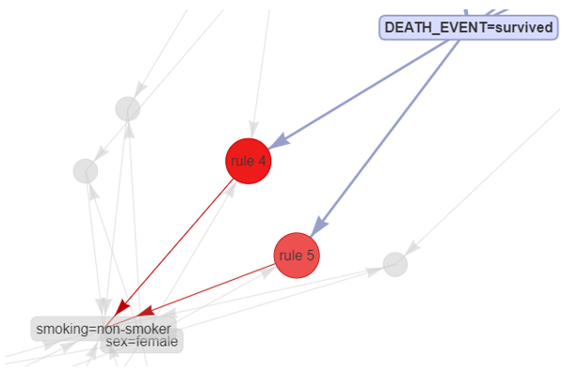
Modeling: Association Rule Mining
Top Rules when RHS set to Death Event
Top Overall Rules

Slide 22
Reflection & Learning Goals
Strong connection between death event and both serum creatinine and ejection.
Age is the dominant factor in heart failure deaths. Older patients are at a higher risk.
Diabetes and high blood pressure were less impactful.
Smokers were highly associated with death events compared to non-smokers.
Skills gained:
Data management
Advanced R packages
Data visualization
Machine learning techniques
Analytical interpretation

Slide 23
IST 736: Text Mining
Course Description
Introduced techniques for analyzing large quantities of text data through clustering, document representation, extraction, classification, and topic modeling.
These techniques were applied alongside various visualization tools in Python to uncover interesting real-world occurrences.

Slide 24

IST 736 – Movie Recommender: Project Description
Goal
To create a movie recommendation system that predicts genre based on movie description using supervised and unsupervised machine learning techniques.
Contributor(s): Gianni Conde, Sana Khan, Sahil Nanavaty

Slide 25
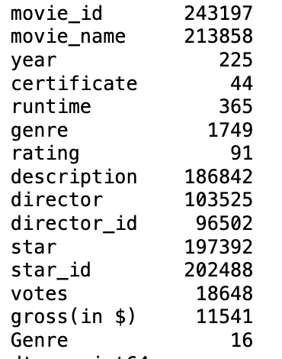
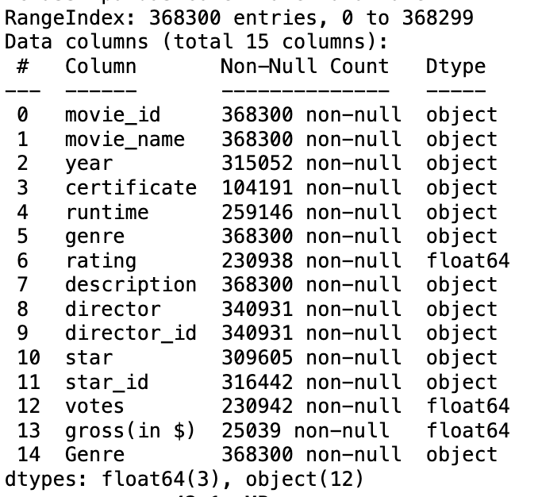
About the Data
Retrieved from Kaggle and originated from IMDB.com
16 separate CSV files that represented a genre.
CSV files were combined into one date frame
368,300 rows, 15 columns

Slide 26
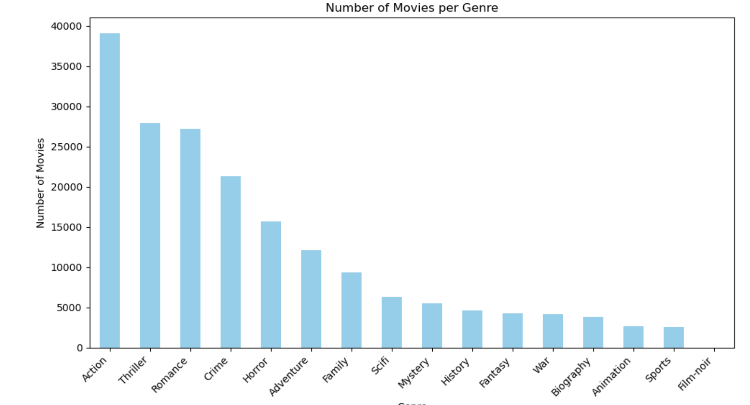
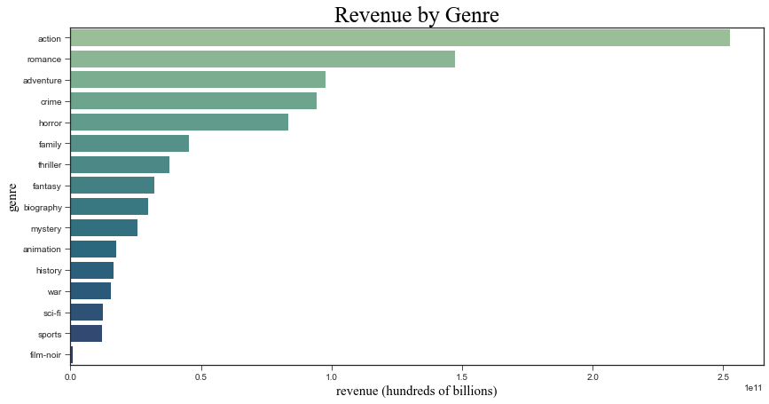
Exploratory Data Analysis
Narrowed down the data set to only include the following genres:
Sci-Fi, Sports, Romance, Crime, Horror

Slide 27
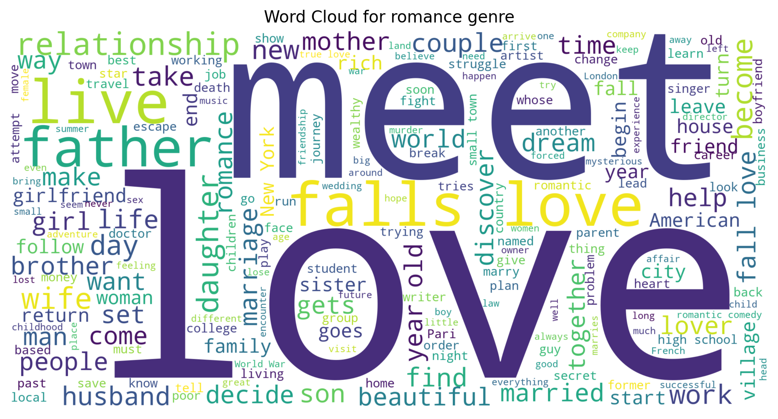
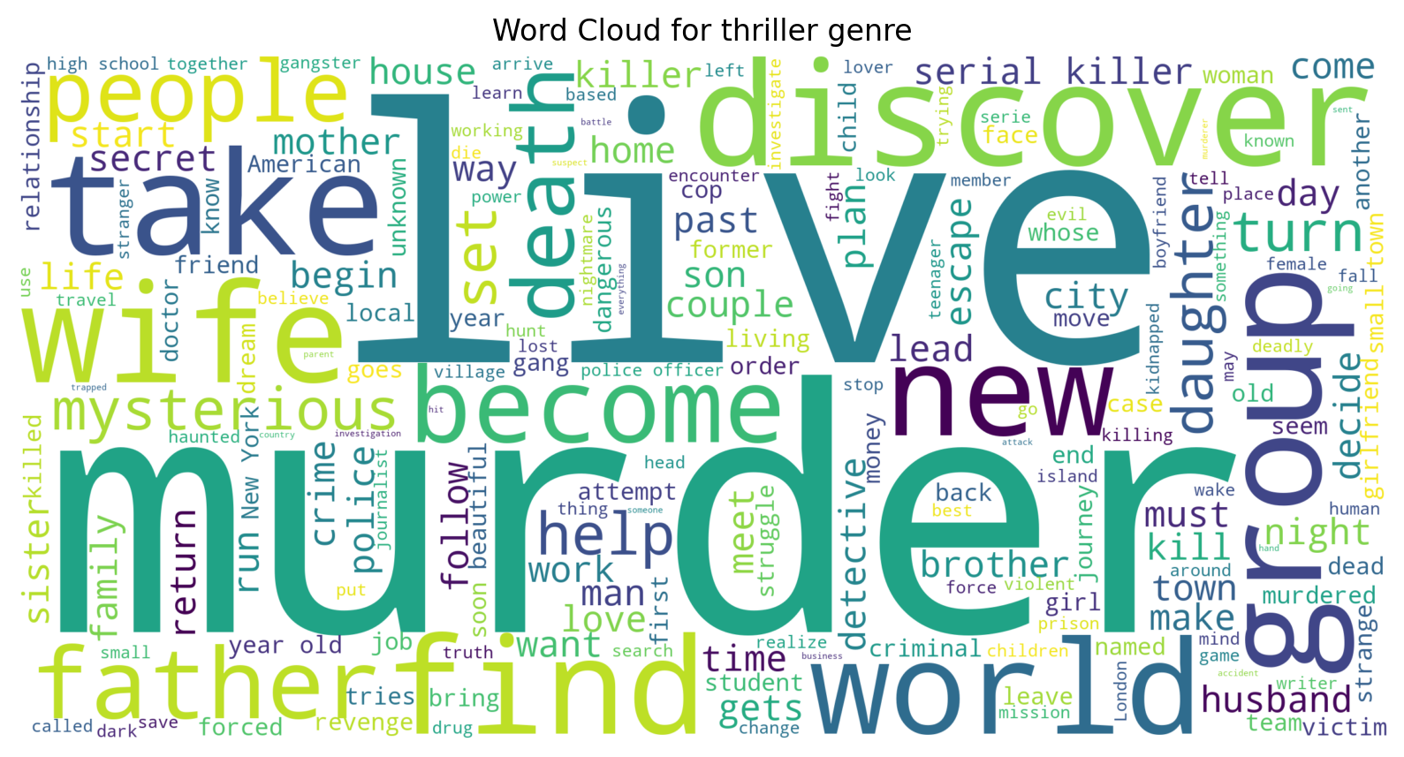
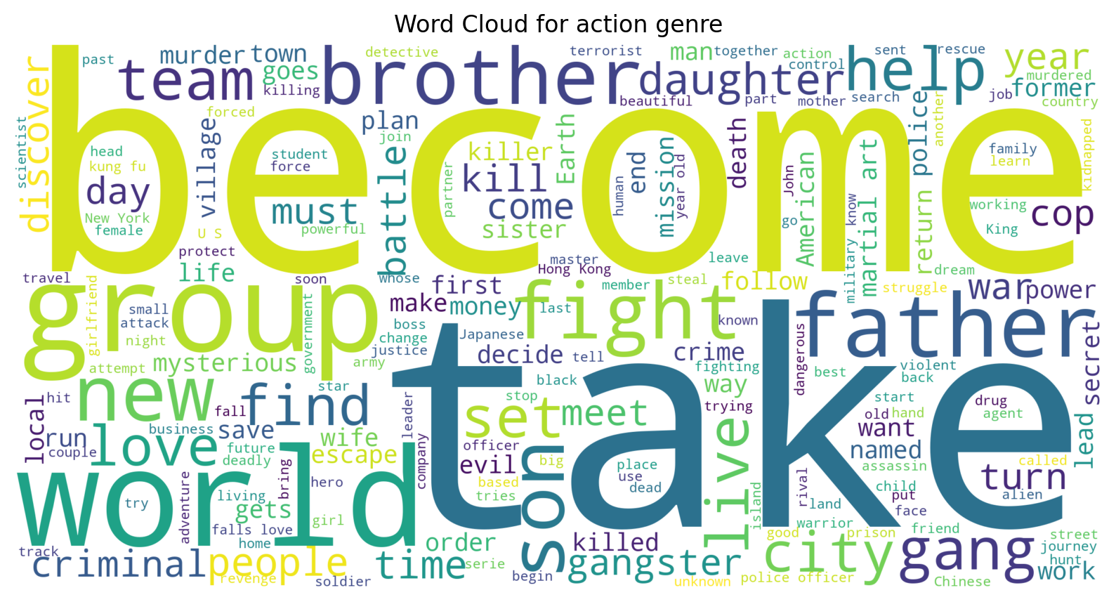
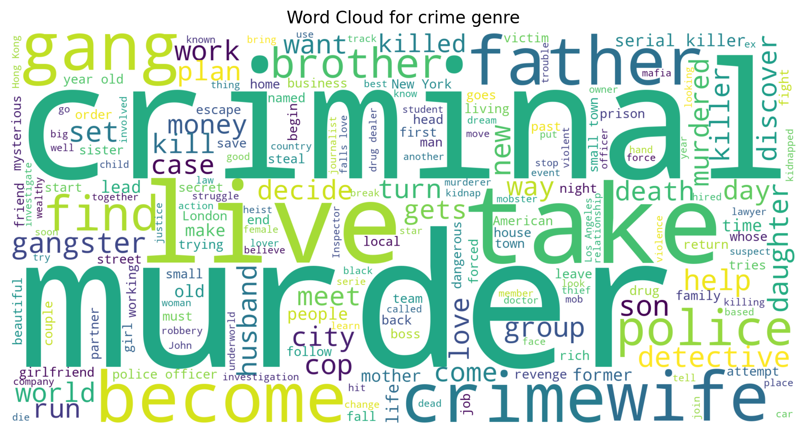
Exploratory Data Analysis (cont.)

Slide 28
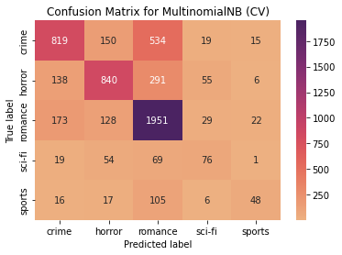
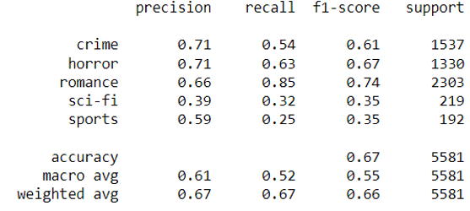
Modeling: Multinomial Naïve Bayes
Accuracy score of 66.91%.
Crime, horror, and romance had the highest overall scores.
Sci-Fi and sports had the lowest scores.
Correct predictions based on recall scores:
Romance: 85%
Horror: 63%
Crime: 54%
Sci-Fi: 32%
Sports: 25%

Slide 29
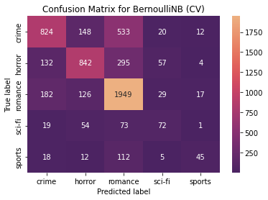
Modeling: Bernoulli Naïve Bayes
Accuracy score of 67%.
Crime, horror, and romance had the highest overall scores.
Sci-Fi and sports had the lowest scores.
Correct predictions based on recall scores:
Romance: 85%
Horror: 63%
Crime: 54%
Sci-Fi: 32%
Sports: 25%

Slide 30
Naïve Bayes Results
Both models produced extremely similar accuracy scores.
This implies that the features are not highly correlated.
The classes (genres) were well separated by the movie description's features (unique words).
Low sci-fi and sports' classification report scores were most likely due to low support (instances).

Slide 31
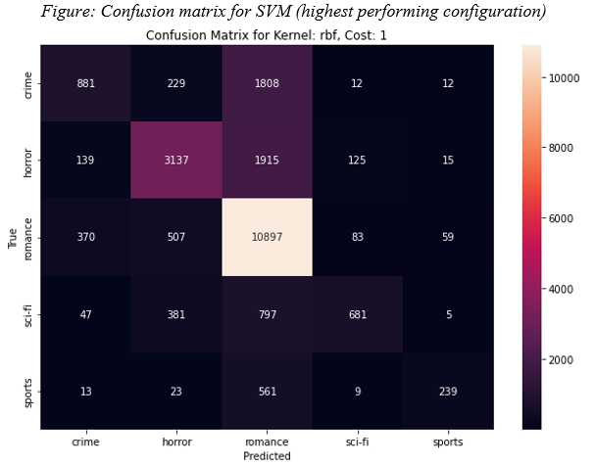
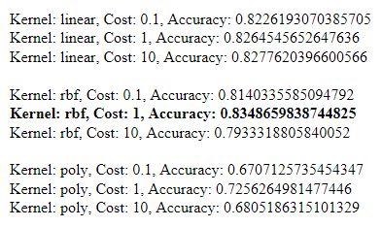
Modeling: SVM
Experimentation with three kernels: linear, radial basis function (RBF), and polynomial.
Various cost values tested to determine optimal model configuration.

Slide 32
SVM Results
Linear: Slight improvement in accuracy with increased cost, suggesting a potential performance ceiling.
RBF: Notable accuracy improvement from cost 0.1 to 1, then a decrease at cost 10 due to potential overfitting.
Polynomial: Lower accuracy overall; moderate cost values improved accuracy, but higher costs led to decreased performance.
Optimal cost values differed across kernels, with moderate values providing the best balance between accuracy and generalization.

Slide 33
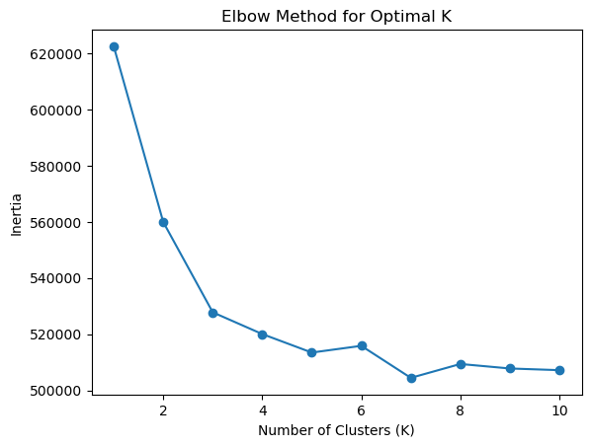
Modeling: K-Means Clustering
Elbow method was used to determine the optimal number of clusters.
The optimal number of clusters is either 3 or 4 since they are within the range of the elbow curve.

Slide 34
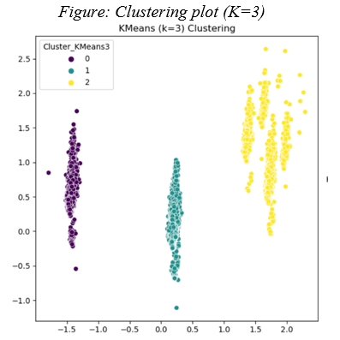
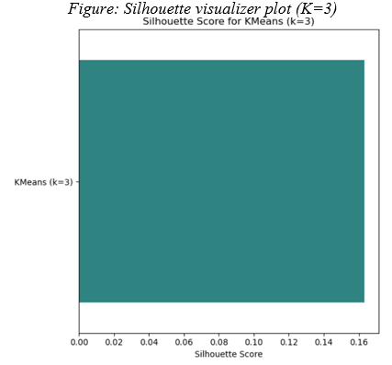
Modeling: K-Means with 3 Clusters
Clusters 0 and 1 formed tight groups suggesting that their variances are smaller.
They share similar words in their descriptions.
Cluster 2 is more dispersed, suggesting more variability in their descriptions.
Ex. Comedy vs. Romantic comedy
The Silhouette score is relatively low at 0.16

Slide 35
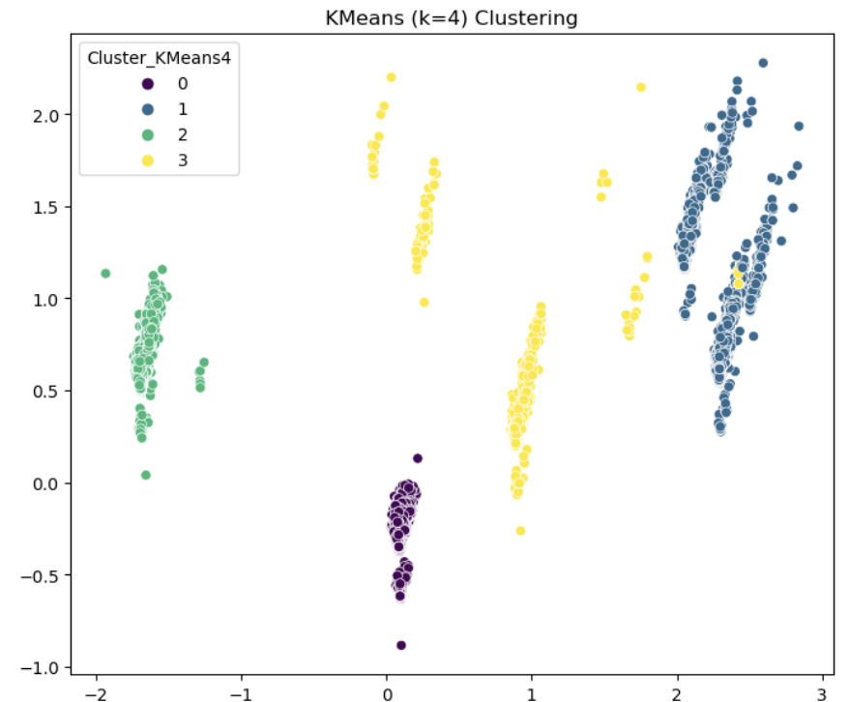
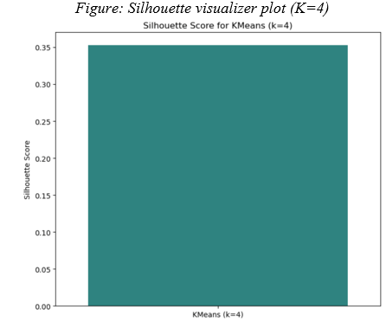
Modeling: K-Means with 4 Clusters
Clusters 0 and 2 are well separated and defined.
Overlap between clusters 1 and 3 exists.
Indicates that there is similarity in the descriptions between genres.
The Silhouette score has improved to 0.35

Slide 36
K-Means Results
Modeling with 4 clusters provided improved results based on Silhouette scores and cluster shapes.
Despite their improvement from the first model, their Silhouette score was still too small.
Indicates that the data does not cluster very well due to ambiguity and overlap in descriptions/genres.

Slide 37
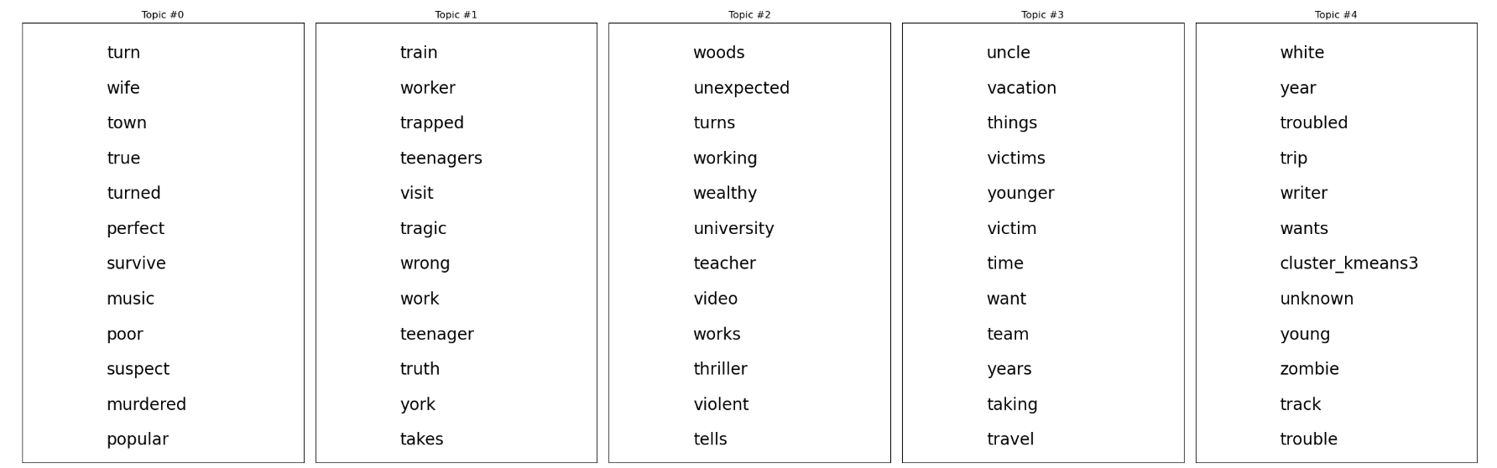
Modeling: LDA
Overlap in description words caused overlap in topics.
Movies can fall under more than one genre, making it difficult to determine definitive words for each topic.

Slide 38
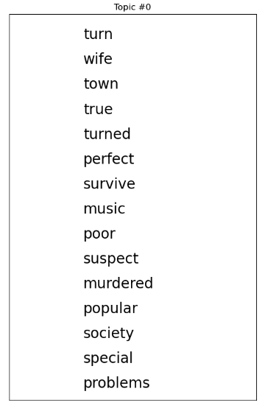
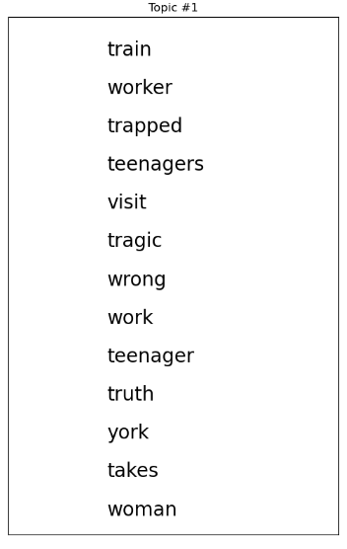
LDA: Topics 0 & 1
Topic 0 could be the crime genre.
Words like murdered, survive, poor, and suspect would align best with movies containing criminal elements.
Topic 1 does not appear to have a clear genre.
Words like woman, tragic, and truth could pertain to any of the 5 genres.

Slide 39
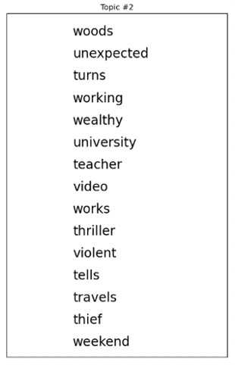
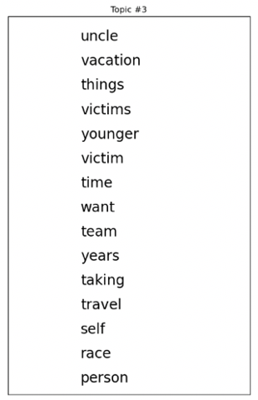
LDA: Topics 2 & 3
Topic 2 could be the horror genre.
Words like woods, unexpected, thriller, and violent, and travels would align best with movies containing elements of horror.
Topic 3 could be the sports genre.
Words like team, travel, and race could pertain to sports films.

Slide 40
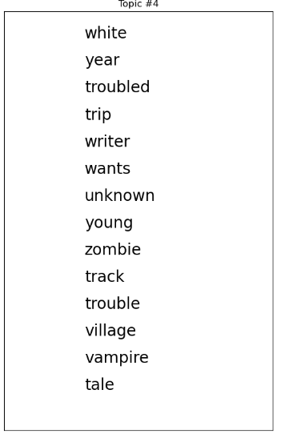
LDA: Topic 4
Topic 4 could be the sci-fi genre.
Words like zombie, vampire, and tale would align best with movies containing sci-fi elements.

Slide 41
LDA Results
Effective at providing a general idea of top features per topic.
Unable to provide definitive genre classifications.
Likely due to overlap between text descriptions and the fact that many movies belong to multiple genres.
Example: Unable to determine Topic 1’s genre initially.
Can infer that after observing the other topics, it must be romance.
LDA may not be the most adequate model for a recommendation system.

Slide 42
Reflection & Learning Goals
The SVM was the superior modeling technique in terms of accurately classifying movie genres.
Complex descriptions and genre overlap proved that text mining alone is not enough to create a stable recommender.
Unsupervised machine learning techniques highlighted difficulties in capturing view preferences.
Skills gained:
Data management (collection, storage, access)
Python libraries (pandas, NumPy, NLTK, etc.)
Data visualization
Supervised and unsupervised machine learning methods
Analytical interpretation

Slide 43

Reflection of Program
The Applied Data Science program has given me the opportunity to gain a well-round understanding of the uses and applications of data science in various industries.
Throughout the coursework and projects presented, I used data related to the realms of sports, finance, medicine, and entertainment.
I also gained invaluable knowledge revolving around data science techniques, models, and programming language fluency that have prepared me for this competitive industry.
I would like to sincerely thank the instructors, advisors, and classmates of the School of Information Studies that have accompanied me on my journey at Syracuse University.

Slide 44
References
“Applied Data Science Master’s Degree - iSchool: Syracuse University.” Syracuse School of Information Studies, Syracuse University, 17 June 2020,
ischool.syr.edu/academics/applied-data-science-masters-degree/.
Larxel. “Heart Failure Prediction.” Kaggle, Version 1. Retrieved 4 Feb. 2020, Accessed 6 Nov. 2022. https://www.kaggle.com/datasets/andrewmvd/heart-failure-clinical-data
Raju, Chidambara G. “IMDb Movie Dataset: All Movies by Genre.” Kaggle, Version 3. Retrieved 17 February 2023, Accessed 24 Feb. 2024.
https://www.kaggle.com/datasets/rajugc/imdb-movies-dataset-based-on-genre
“Roster Resource - Free Agent Tracker.” FanGraphs, FanGraphs Baseball, 30 June 2022. https://www.fangraphs.com/roster-resource/free-agent-tracker?&season=2022
Wang, Man, and Lauren Juiliani. “IST - 707.” Answers, Syracuse University, 16 Nov. 2021, answers.syr.edu/display/ischool/IST+707+-+Applied+Machine+Learning.
Wang, Man, and Margaret Craft. “IST 659 - Database Administration Concepts & Database Management.” Answers, Syracuse University, 29 Apr. 2021,
answers.syr.edu/pages/viewpage.action?pageId=105104343.
Wang, Man, and Margaret Craft. “IST 736 - Text Mining.” Answers, Syracuse University, 19 Apr. 2021, answers.syr.edu/display/ischool/IST+736+-+Text+Mining.

